Slide 1

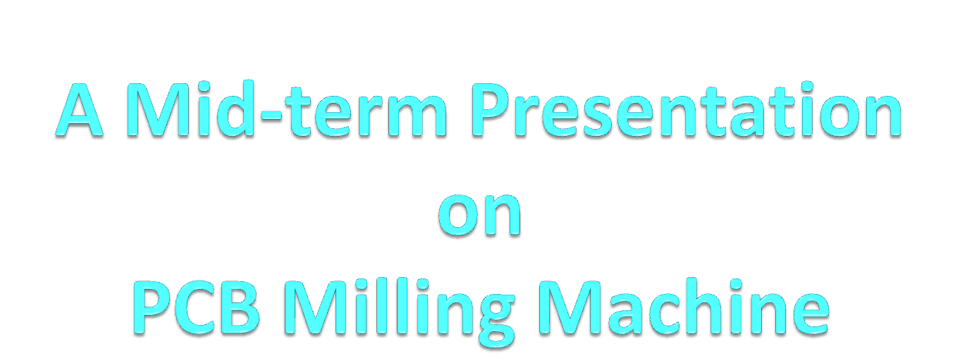

Slide 2
Members:
Aashish Poudel (060 BEX 401)
Anjan Narsingh Rayamajhi (060 BEX 402)
Anup Shrestha (060 BEX 405)
Bikash Sharma (060 BEX 407)
Jeewan Shrestha (060 BEX 414)
Project Supervised by:
Er. Ramesh Chaudhary
Dept. of Mechanical Engineering
Er. Niraj Tamrakar
Dept. of Electronics and Computer Engineering

Slide 3
Topics of discussion
Introduction
Objectives
Methodology
A little more on our project
Member’s contribution
Expected output
Progress and Achievements
Scope & Limitations
Problems faced

Slide 4

Introduction
PCB layout
PCB Milling Machine
∑
Electronic Control
Mechanical Milling
Not the chemical way but mechanical…

Slide 5

Objectives
Simply, to develop a CNC based PCB Milling Machine
Specifically,
  stepper motor controller/driver
  interpret the 'Gerber File‘
  generate the double line structure
  implement the vector drawing
  serial communication

Slide 6

Methodology
Study and Research
  Past papers
  Textbooks
  Market
Tools Used
  FreePCB
  Visual C#
  Robotics club assistance
  89s51 microcontroller
Idea from a past project entitled ‘Automated Engraver’

Slide 7
Our project in more detail…

Slide 8
From the Gerber to the Outline Format

Slide 9
Analysis of Gerber Format
Start
standard format produced by most of the CAD PCB designing software
It is divided into blocks for easy manipulation
e.g. G01X0Y2400000D01
The one-character function codes such as G codes, D codes, M codes describes how coordinates should be interpreted
e.g. D01 for linear interpolation
Read and parse
each block of Gerber file
No
Block starts
With G01?
Yes
Note the coordinates
along with D code functions
Read Next Block
Finished
Reading
all blocks?
No
Yes
Stop

Slide 10


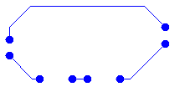
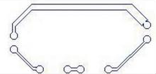
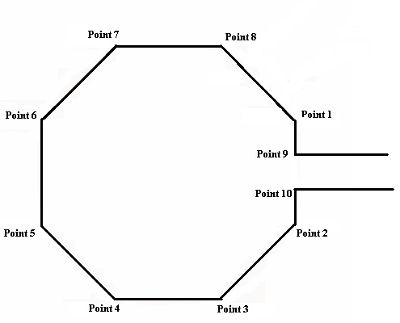
Algorithm for Producing Outline…
Ideal conversion
Our conversion

Slide 11
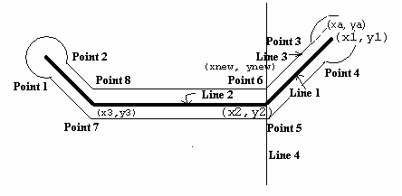
Algorithm for Producing Outline
Circle is interpolated with octagon
With known width, the first double line points in a continuous trace are approximated
The next double line points are derived with the slopes of
single lines and the preceding double line point
Finding Intersection Point (point 6)

Slide 12

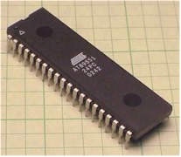
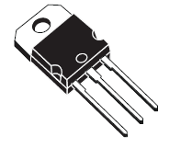

The control and the controller
Controller
Driver
Control Data
Stepper Motors

Slide 13
The control Data
Control word
X step (Q)
X step (R)
Y step (Q)
Y step (R)
X delay (U)
X delay (L)
Y delay (U)
Y delay (R)
Required information to the Controller
Serially deploy information calculated by software
control word should contain information on,
  X/Y direction of rotation
  Milling bit ON/OFF and parity check
Per block 8 bits
Q : Quotient
R : Remainder
U : Upper Byte
L : Lower Byte

Slide 14
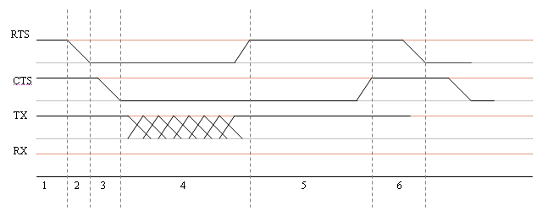
The Controller
Atmel® AT89S51 microcontroller
Serial communication
Using Timers to implement Vector Drawing Technique
Sequencing the stepper motors
1: Computer calculating
2: Ready to Send
3: Controller ready to receive
4: Data transmission
5: Controller working
6: Computer ready to send again…

Slide 15
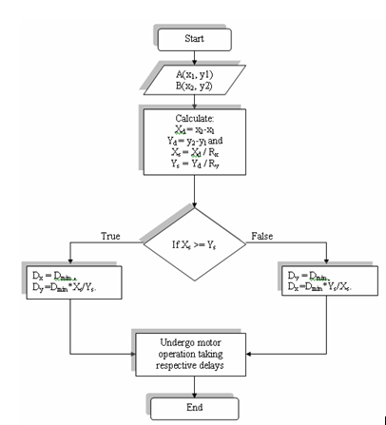
The vector Drawing Technique

Slide 16
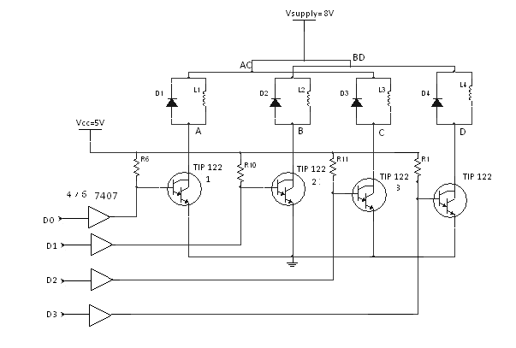
Driver
Darlington Pair
Requirement of high current up to 1 Ampere
current capacity up to 5A (3A at 1 V drop for Ic = 250 Ib)
collector dissipation of 2W without heat sink at 25 °C as rated.

Slide 17
Stepper Motors
Digital electro-mechanical device
Position control with open loop feedback
Based on the command pulses the motor rotates
Variable reluctance motor
Unipolar three/ four phase motors
Step angle 3.75° and 7.5°

Slide 18
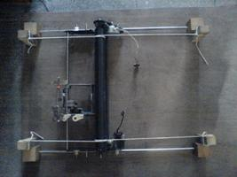
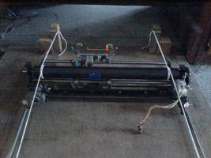
The machine
Head
XY positioning System
X direction using belt driving mechanism
Y direction using rope driving mechanism
X direction linear resolution is 0.22mm per step
Y direction linear resolution is 0.16mm per step
Gear reduction to increase torque
Rope Driving Mechanism
Belt Driving Mechanism

Slide 19

Member’s Contribution
Software designing and Implementation
  Aashish Poudel
  Anup Shrestha
Controller design and implementation
  Anjan Nr. Rayamajhi
  Bikash Sharma
  Jeewan Shrestha
Machine realization
  Everyone

Slide 20
Expected Output
A finely drawn double line PCB with horizontal, vertical and inclined lines and circles.
Only single layer PCB
Precise control of all 3 stepper motors
A working platform for design and milling of PCBs

Slide 21

Progress and Achievements
Completed
  Base structure and 2D XY motion
  Power supply
  Control circuit
Partly Completed
  Software to interpret Gerber file
  Serial communication between PC and microcontroller
To be completed
  Head for placing milling bit
  Limiting switches at the ends of working area

Slide 22
Scope and Limitations
Scope
  A single layer PCB
  Serial communication
Limitations
  Low component density due to double line structure
  Can’t incorporate all the features in complicated PCBs
  Relies on 3rd party software for making Gerber file
  No USB support

Slide 23
Problems faced
Developing efficient algorithm for double line format
Unavailability of PIC led us to abandon USB
Mechanical system realization
Power supply had to deliver large current, heating problem
Slipping in the mechanical system still prevails

Slide 24
References
Ayala, K. J., “The 8051 Microcontroller: Architecture, Programming and Applications”, 2nd Edition, P. 54-87, Thomson Asia Pte. Ltd.
Hall, Douglas V. , “ Microprocessors and Interfacing: Programming and Hardware”, 2nd Ed., P. 281-283, Tata McGraw-Hill Edition
Nanfara, F., Uccello, T., Murphy, D.,”The CNC Workshop: A Multimedia Introduction to Computer Numerical Control”, P. 2-16, Addison Wesley Longman, Inc.
Sedra, A.S., Smith, K.C., ”Microelectronic Circuits”, 4th Edition, Oxford University Press
Tamrakar, I. ,”Course Manual on Electrical Machines – I”, P. 114-117, CIMDU
Gopal K. Dubey ,”Fundamental of electrical drives”, Second Edition, Narosa Publishing House.
Microchip's documents on stepper motors and Various Websites

Slide 25


